Slide 1

Dataset EDA

Slide 2

Zomato API Analysis is one of the most useful analysis for foodies who want to taste the best cuisines of every part of the world which lies in their budget. This analysis is also for those who want to find the value for money restaurants in various parts of the country for the cuisines. Additionally, this analysis caters the needs of people who are striving to get the best cuisine of the country and which locality of that country serves that cuisines with maximum number of restaurants.

Slide 3
Problem:
The basic idea of analyzing the Zomato dataset is to get a fair idea about the factors affecting the establishment of different types of the restaurant at different places, aggregate rating of each restaurant.
With each day new restaurants opening the industry hasn't been saturated yet and the demand is increasing day by day. Inspite of increasing demand it, however, has become difficult for new restaurants to compete with established restaurants.
Most of them serving the same food. Delhi being the capital of India. Most of the people here are dependent mainly on the restaurant food as they don’t have time to cook for themselves.

Slide 4
Insights:
The Objective of this project is to get an idea of following :
Top 3 Countries that uses Zomato?
Understanding the Rating aggregate, color and text
What type of food is like by people in various places?
Which restaurant they like most?
What kind of Cuisine these highly rates restaurants offer ?
How many of such restaurants accept online delivery?

Slide 5
Zomato Dataset Columns Description
Restaurant Id: Unique id of every restaurant across various cities of the world
Restaurant Name: Name of the restaurant
Country Code: Country in which restaurant is located
City: City in which restaurant is located
Address: Address of the restaurant
Locality: Location in the city
Locality Verbose: Detailed description of the locality
Longitude: Longitude coordinate of the restaurant's location
Latitude: Latitude coordinate of the restaurant's location
Average Cost for two: Cost for two people in different currencies 👫
Is delivering: yes/ no
Switch to order menu: yes/no
Price range: range of price of food
Aggregate Rating: Average rating out of 5
Rating color: depending upon the average rating color
Rating text: text on the basis of rating of rating
Votes: Number of ratings casted by people
Has Table booking: yes/no
Has Online delivery: yes/ no
Currency: Currency of the country
Cuisines: Cuisines offered by the restaurant

Slide 6
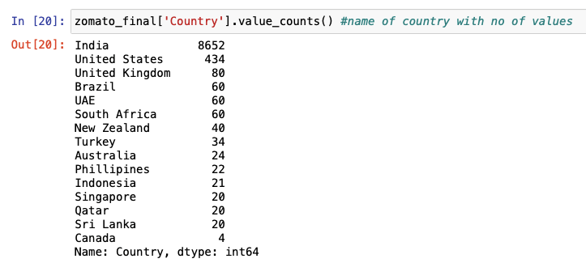
Top 3 Countries that uses Zomato
Observations:
Zomato is mostly used in India.
In USA, they just have a website, which they will recommend some kind of restaurants.
Main base of Zomato is in India

Slide 7
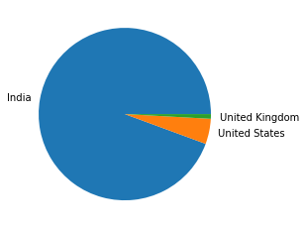
Visualized Form:
Observation-
Most Revenue is generated in India
Max sales in India is approx is 94.32%
In United States max sales approx is 4.73%
In United Kingdom max sales approx is 0.87%

Slide 8
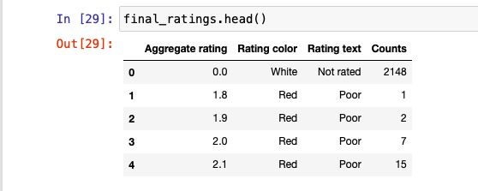
Understanding the Rating aggregate, color and text
Rating 0 - White - Not rated
Rating 1.8 to 2.4 - Red – Poor
Rating 2.5 to 3.4 - Orange – Average
Rating 3.5 to 3.9 - Yellow – Good
Rating 4.0 to 4.4 - Green - Very Good
Rating 4.5 to 4.9 - Dark Green – Excellent

Slide 9
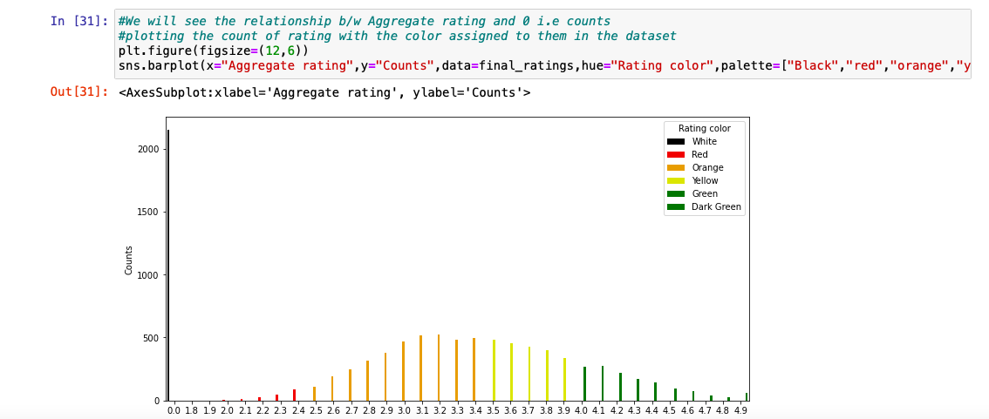
Understanding the Rating aggregate, color and text
0 rating is more than 2000
Top rated is 4.9 rating
It looks like a Guasian curve i.e Normal distribution

Slide 10
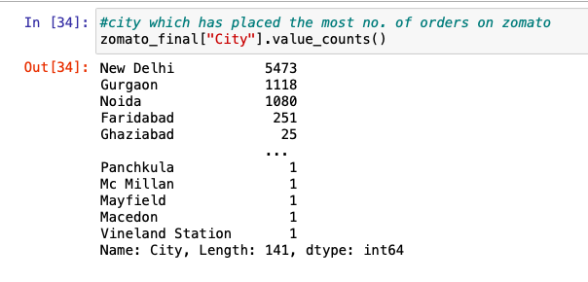
Let us try to understand the coverage of city:
New Delhi has placed the most number of orders followed by Gurgaon then Noida

Slide 11
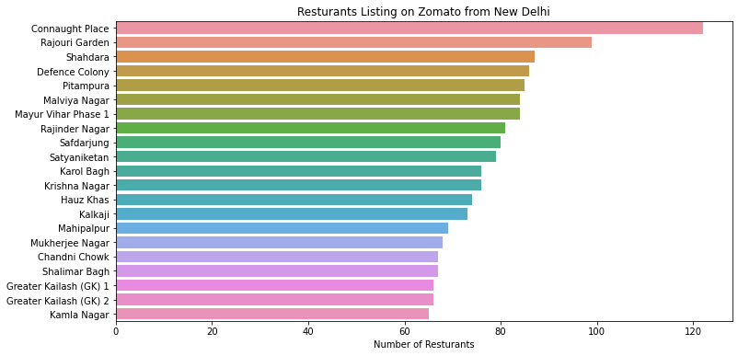
From which New Delhi Locality maximum restaurants are listed in Zomato
Observation:
Connaught place seems to have a high no of restaurants registered with Zomato,
Now, Let us understand the cuisines the top-rated restaurants have to offer.

Slide 12
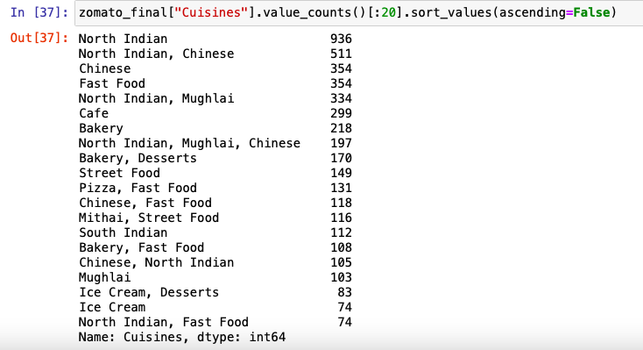
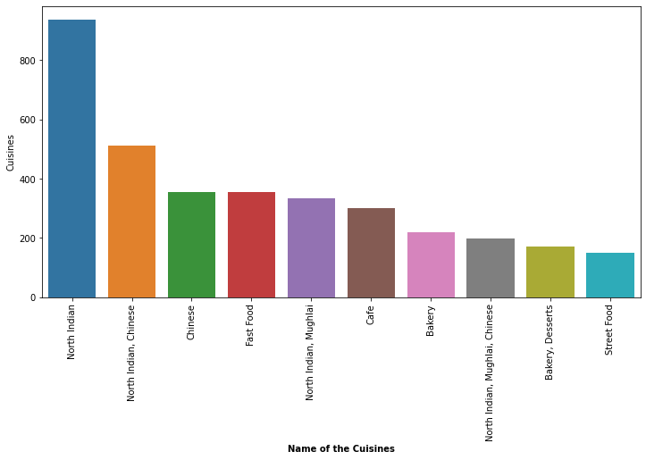
What kind of Cuisine these highly rates resturants offer?
Observation:
Top rated resturants seems to be doing well in the following cuisines:
North Indian
Chinese
Fast Food
Mughlai

Slide 13
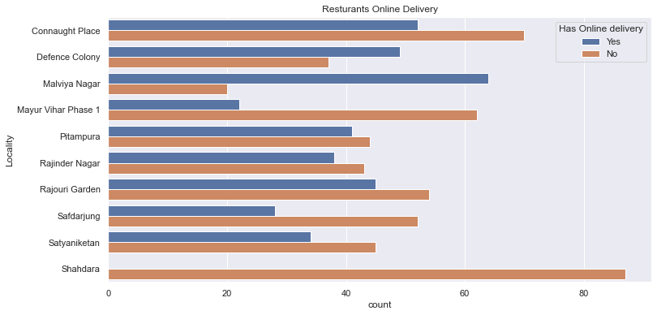
How many of such resturants accept online delivery
Observations:
Apart from Shahdara locality, restaurants in other localities accept online delivery.
Online Delivery seems to be on the higher side in Connaught Place and Malviya Nagar.

Slide 14
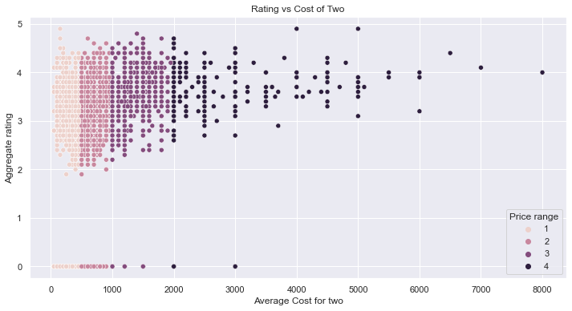
Rating vs Cost of dining
Observation:
There is no linear relation between price and rating.
For instance, Restaurants with good rating (like 4-5) have restaurants with all the price range and spread across the entire X axis

Slide 15
Conclusions:
We've drawn many inferences from the survey. Here's a summary of a few of them:
1. The dataset is skewed towards India and doesnt represent the complete data of resturants worldwide.
2. Resturants rating is categorised in six categories
Not Rated
Average
Good
Very Good
Excellent
3. ConnaughtPlace have maximum resturants listed on Zomato but in terms of online delivery accpetance maliva nagar seems to be doing better.
4. The top rated resturants seems to be getting better rating on the following cuisines:
North Indian
Chinese
Fast Food
Mughlai
5. There is no relation between cost and rating. Some of the best rated resturants are low on cost and vice versa. The analysis is simple. The more exotic the cuisine gets the more rating it has.

Slide 16
